Slide 1


Introduction to Scripting your Web GIS with ArcGIS API for Python
Rohit Singh Atma Mani
rsingh@esri.com amani@esri.com
Notes:
Esri Corporate Template-Dark v3.3
16:9 version – January 21, 2016
For more templates, sample files, and icons, see https://compass.esri.com/resources/presentations/Pages/Main.aspx
To add footer text in Windows
On the Home tab, under Insert, click Text, and then click Header and Footer.
Click the Slide tab, select the Footer check box, and then type the footer text that you want.
Click either Apply or Apply to All.
To add footer text on a Mac
On the View menu, select Header and Footer.
Select the Footer check box and then type the footer text that you want.
Click either Apply or Apply to All.
If footers don't appear on the slides
If footers don't appear on title slides, in the Header and Footer dialog box make sure the Don't show on title slide check box is not selected.
If the footers are missing from other slides, the placeholders for these items might have been removed from specific slide layouts or the slide master.

Slide 2

ArcGIS API for Python
What is it?
Pythonic representation of your GIS
Powerful, modern and easy to use
Implemented using REST + local capabilities

Slide 3
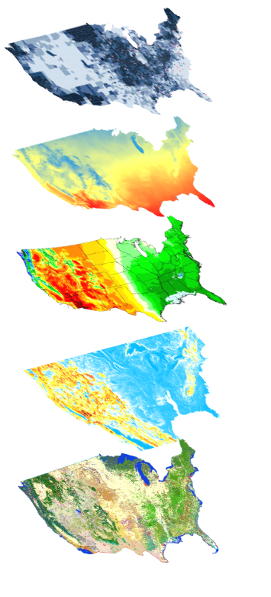
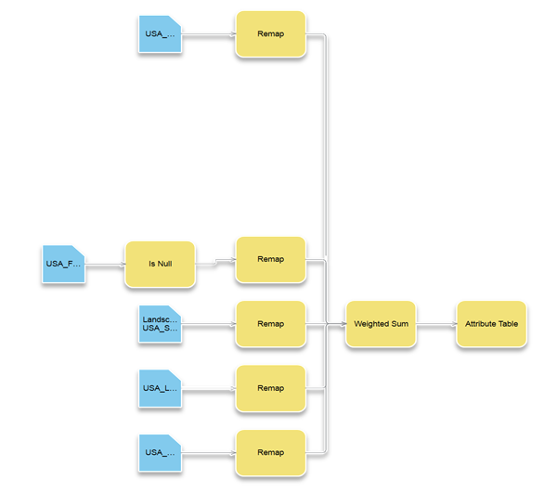
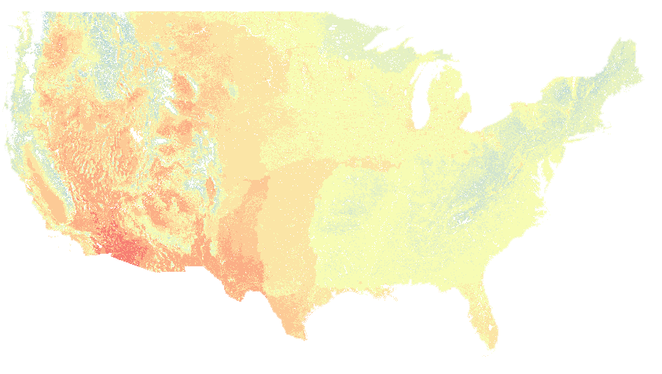

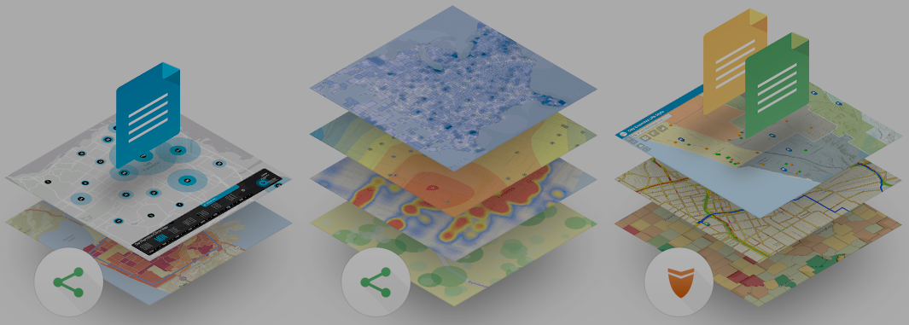
ArcGIS API for Python
Big Data
Spatial Analysis
Raster Analytics
Who is it for?
Imagery
Location Analytics
Feature Analytics
Platform API
Power Users
Developers
Analysts
Data Scientists
Enterprise Integration
Users, Roles & Group management
Administrators
DevOps
Content Publishers
Your Web GIS
Script and automate your Web GIS
Data Management

Slide 4

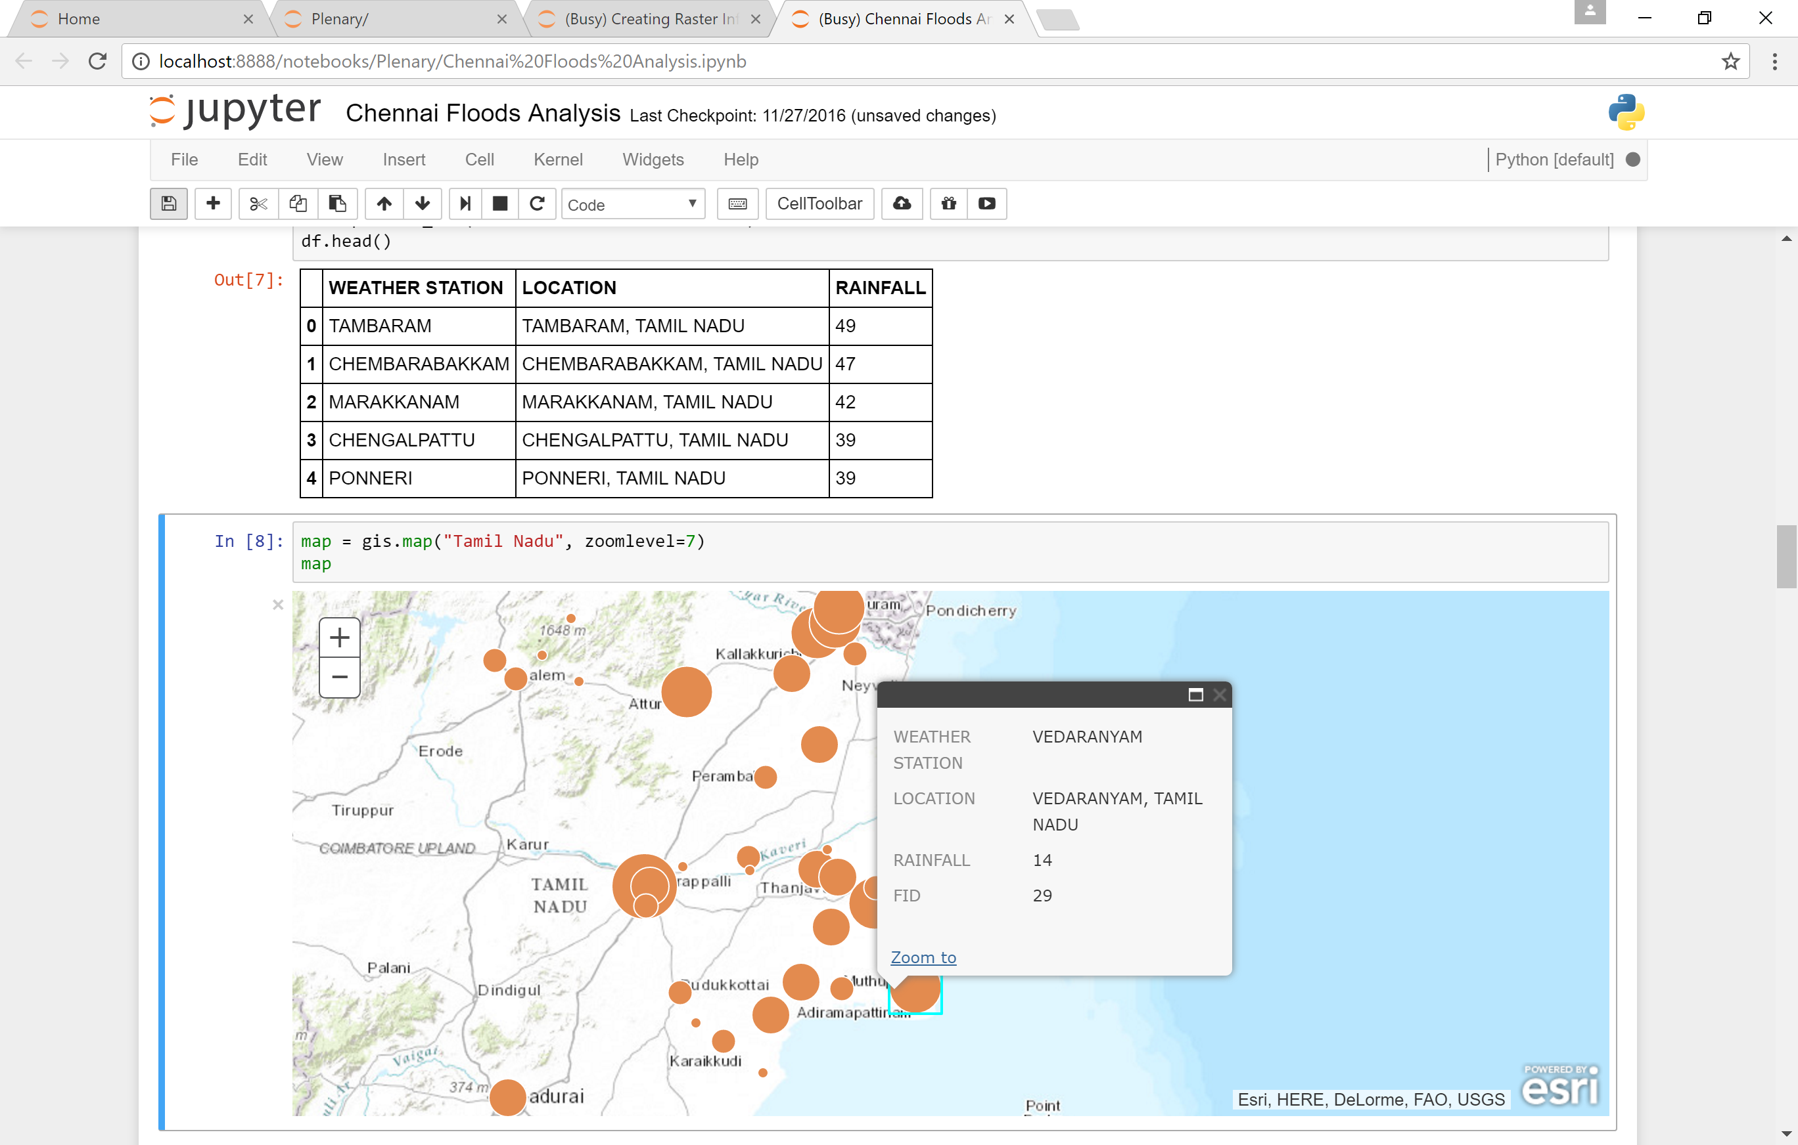
Demo Quick start
Notes:
Quickstart
Admin
CA Fires
Hurricans and Raster

Slide 5
Demo
Desktop
Apps
Automating administrative workflows with Python API
WebGIS Automation
Notes:
Quickstart
Admin
CA Fires
Hurricans and Raster

Slide 6
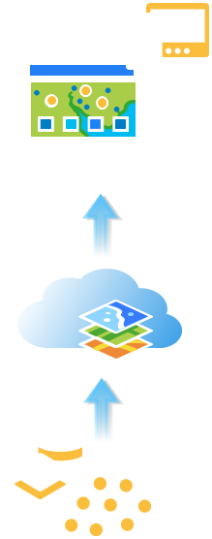
Demo
Content
Publishing
Automating content creation with Python API
Notes:
Quickstart
Admin
CA Fires
Hurricans and Raster

Slide 7
Demo
Interactive
Exploration
GIS Analysis
Analysis with Python API
Big Data GeoAnalytics
Spatial Analysis & Geoprocessing
Notes:
Quickstart
Admin
CA Fires
Hurricans and Raster

Slide 8

Automate WebGIS management
Reproducible research
What can it do for you?
Populate portal with users, groups
Clone portals
Reassign user content
Perform comprehensive content search
Determine item relationship
Create reports of users, their items
Access big data tools programmatically
Utilize rich 3rd party Python packages for data analysis
Create rich charts, graphs, embed 2D and 3D maps in Jupyter Notebook environment
Share your research with data and notes with peers
Automate content creation
Automate content publishing during off peak hours
Update tiles and features from a known database
Replicate development environment content to production
Inspect and update items with broken service links
Notes:
How can all 3 personas benefit from the API?
- Admins, instead of using the UI and getting distracted from their work, can automate most of their common workflows as scripts and schedule them to run at periodic intervals
- Publishers can take care of repetitive content creation and content validation workflows through scripts and schedule them to run at known times
- scientists all over in every discipline love the Jupyter notebook environment. We have added our own enhancements in the form of widgets. Analysts can prototype algorithms, inspect datasets, and visualize their datasets. They can finally share all their work, notes, outputs as Jupyter notebooks, or publish them as html pages to their blogs.

Slide 9
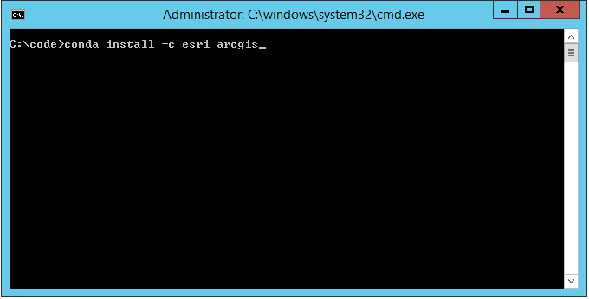
How do you get this?
Distributed via Conda
Simplifies installs & updates
Installs dependencies
Avoids conflicts
Install steps:
Download Anaconda
conda install –c esri arcgis

Slide 10

How do you get this?
Distributed via Conda
Simplifies installs & updates
Installs dependencies
Avoids conflicts
Install steps:
Download Anaconda
conda install –c esri arcgis

Slide 11
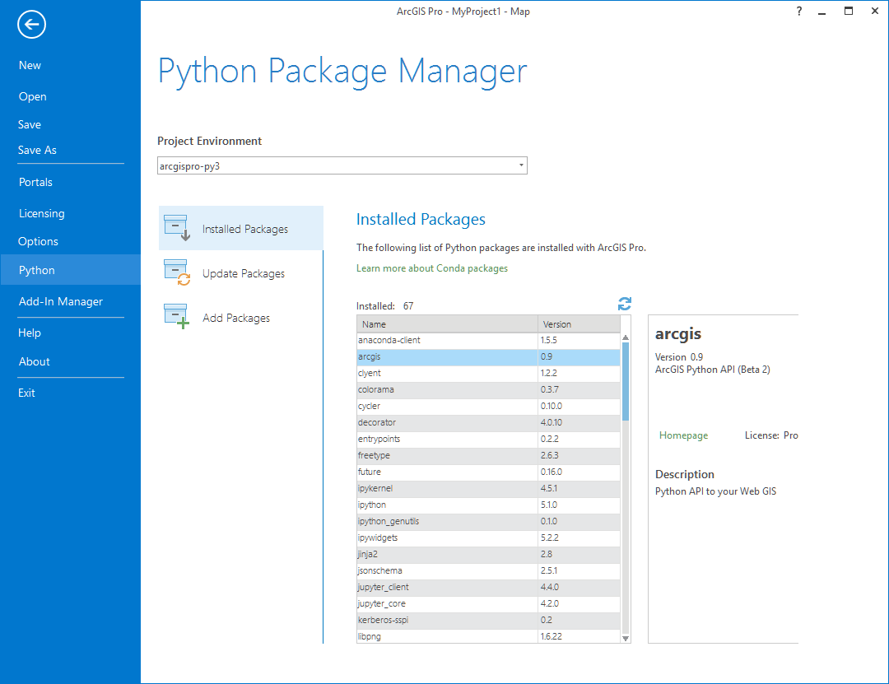
Have ArcGIS Pro?
ArcGIS Pro includes conda
Follow steps from install guide to install arcgis package...

Slide 12

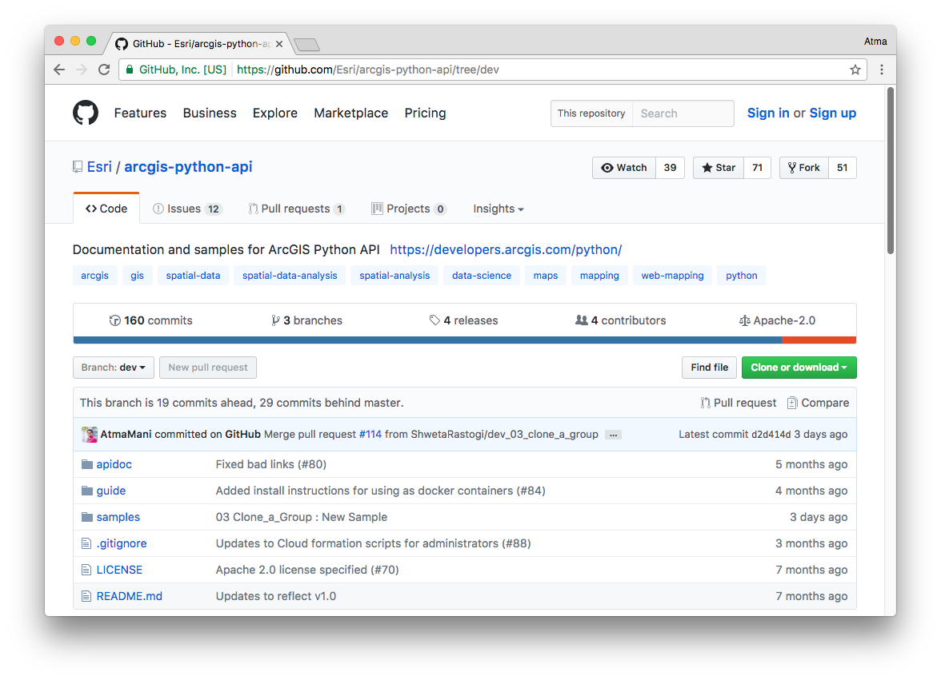
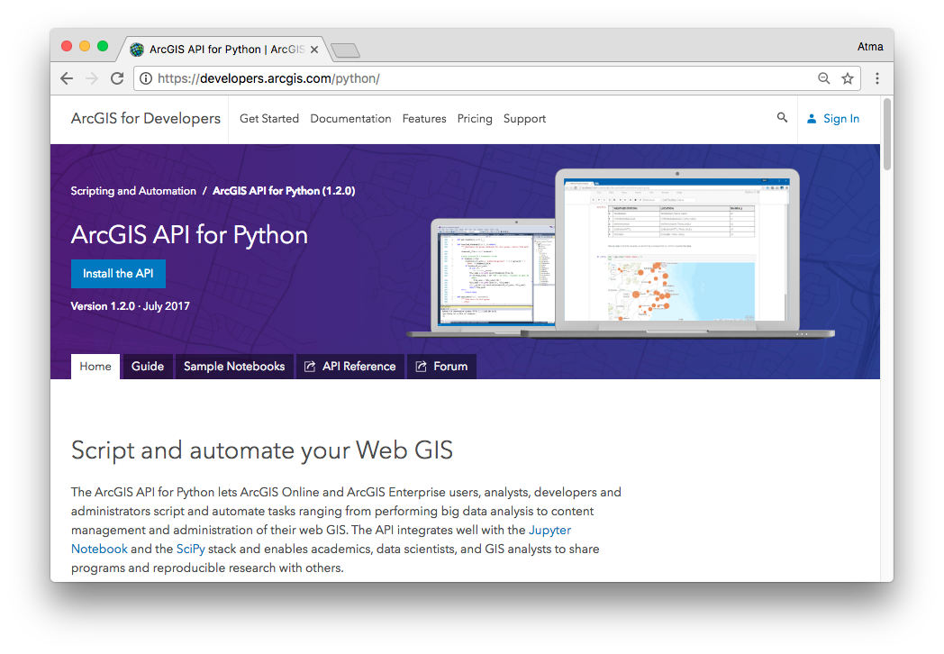
Resources
github.com/Esri/arcgis-python-api
developers.arcgis.com/python

Slide 13
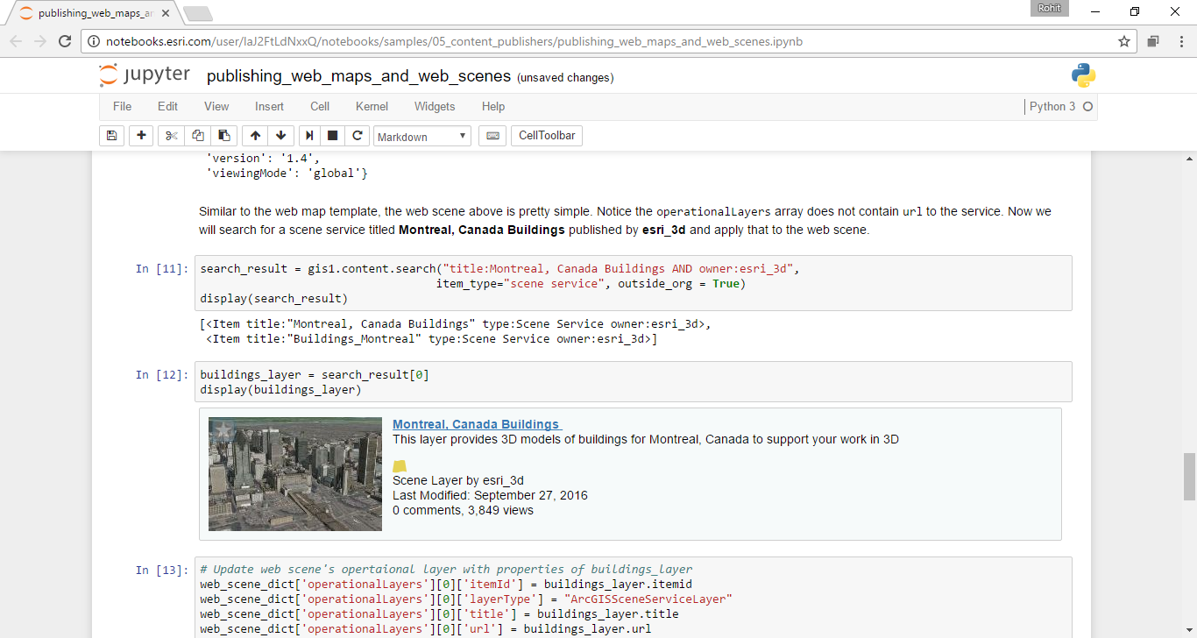
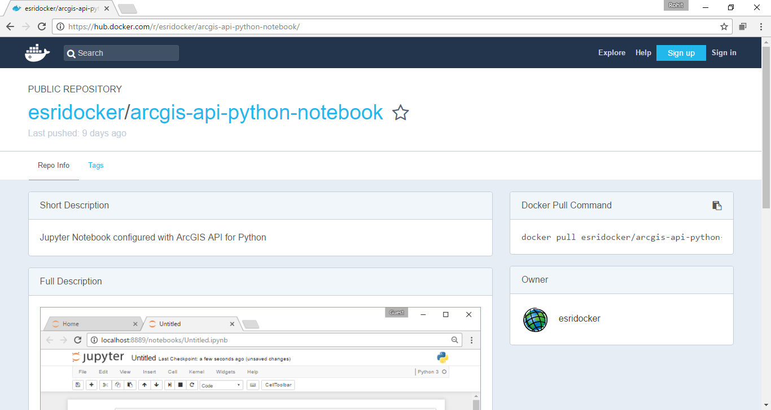
Resources
Notebooks.esri.com
hub.docker.com/r/esridocker

Slide 14
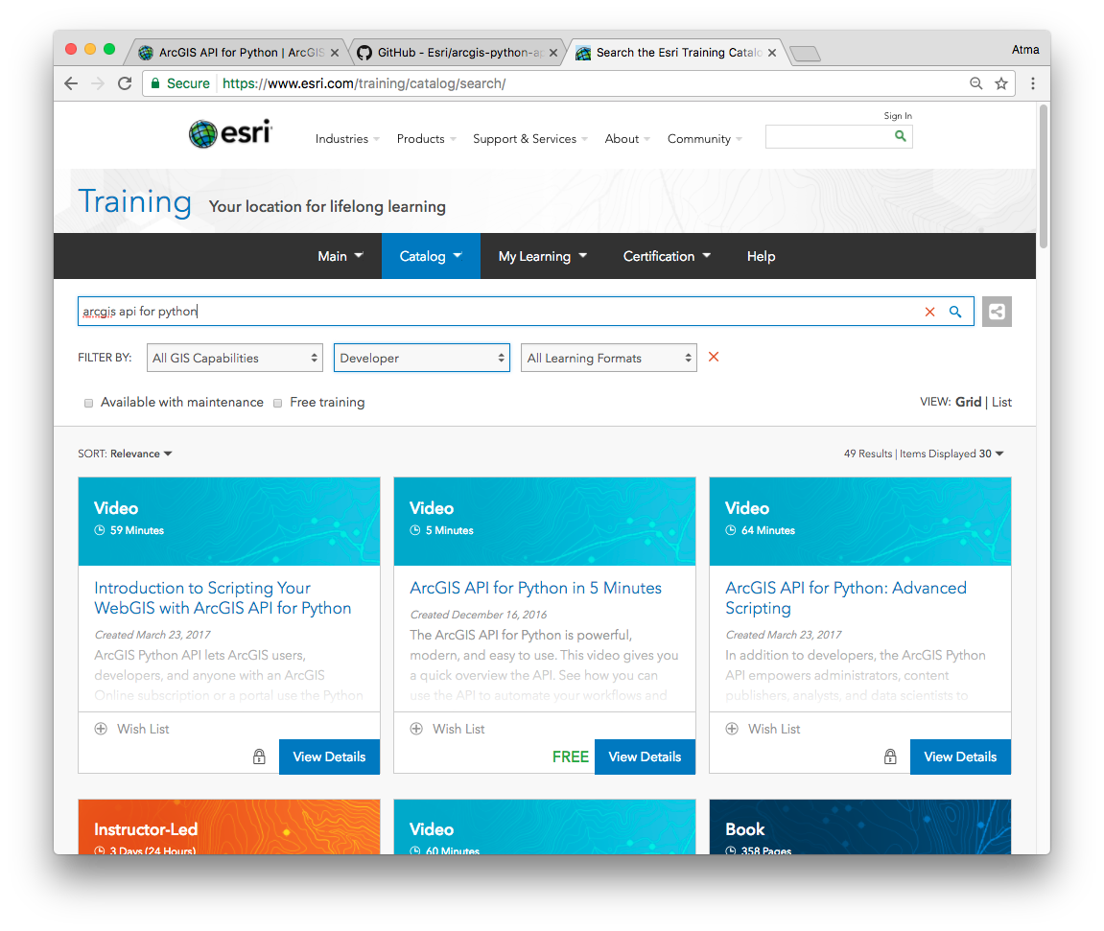
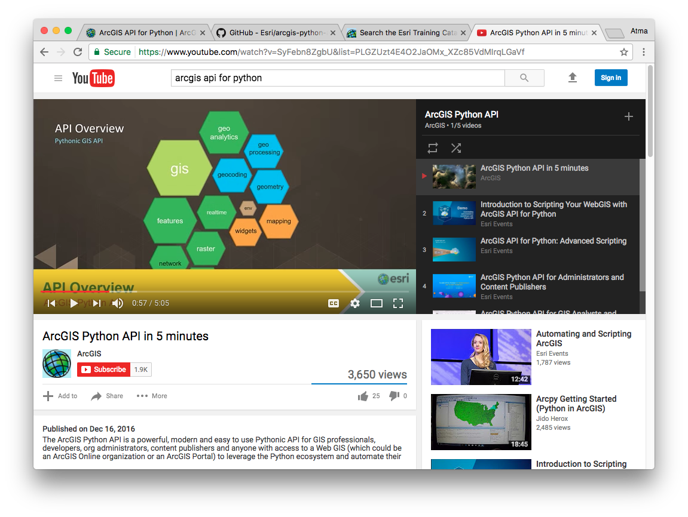
Resources
www.esri.com/training
youtube.com playlist

Slide 15
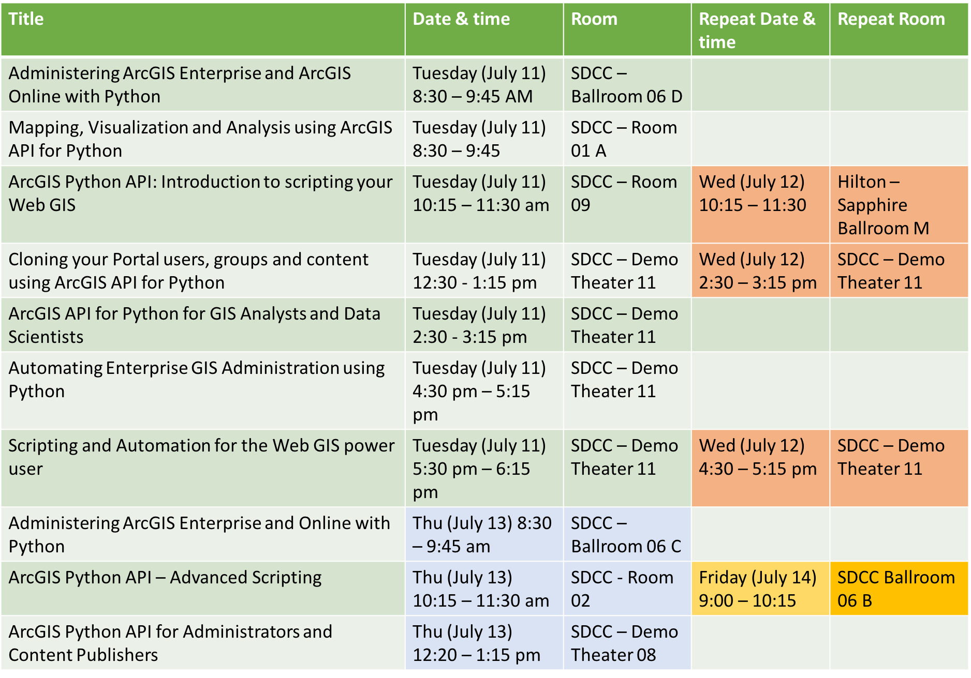

Slide 16


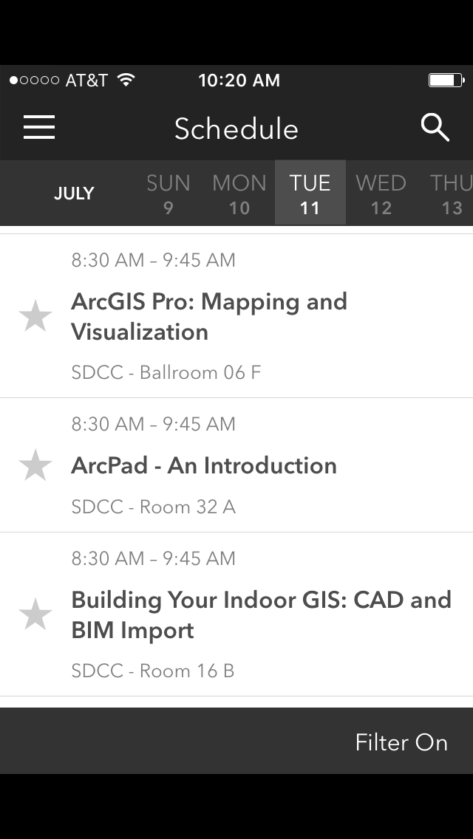
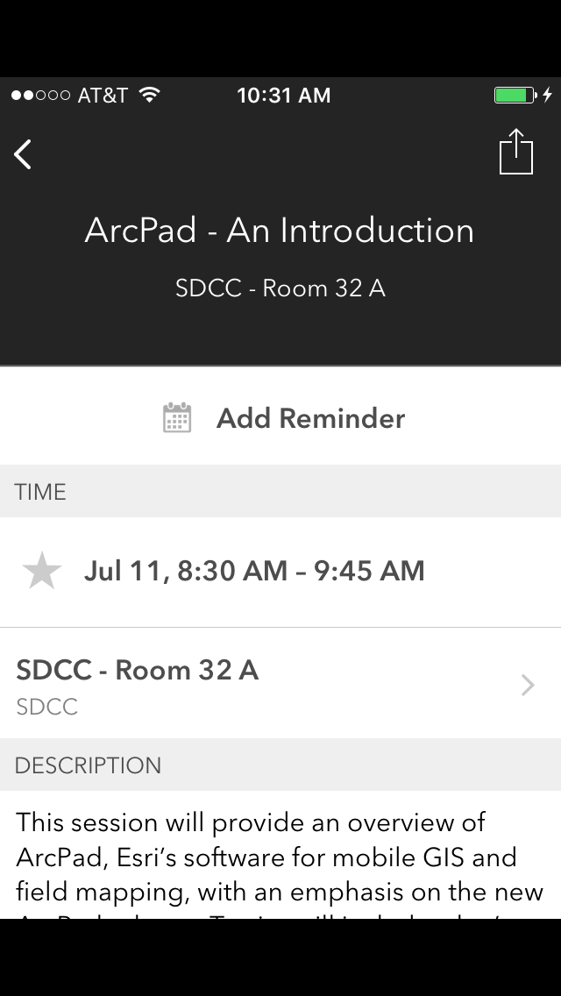
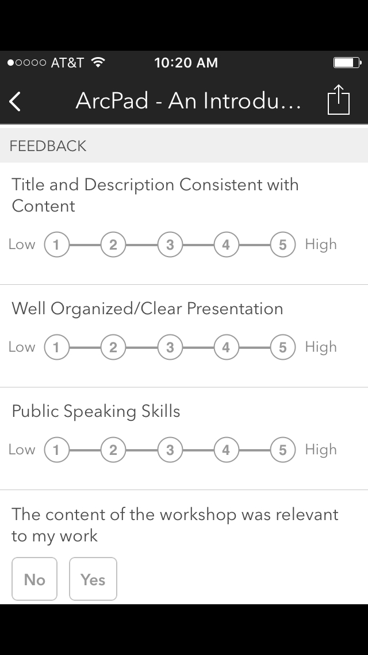
Please Take Our Survey on the Esri Events App!
Download the Esri Events app and find your event
Select the session you attended
Scroll down to find the survey
Complete Answers
and Select “Submit”

Slide 17
Questions?

Slide 18


Thank you

